Slide 1
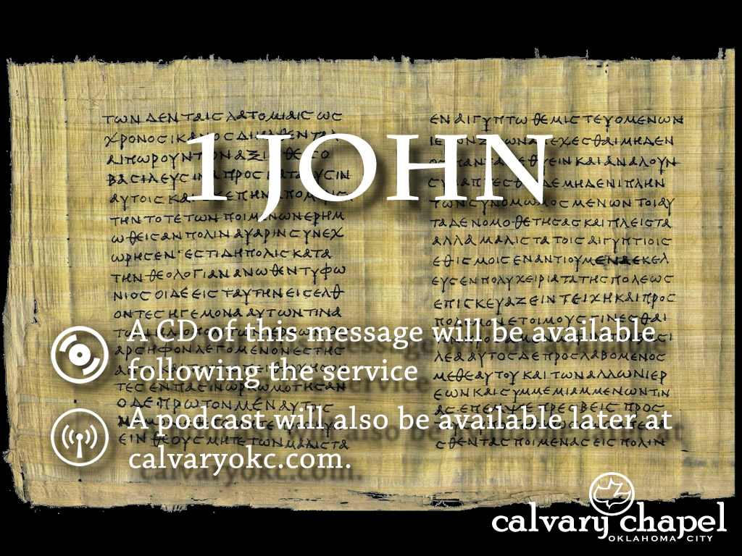
1:5-10

Slide 2
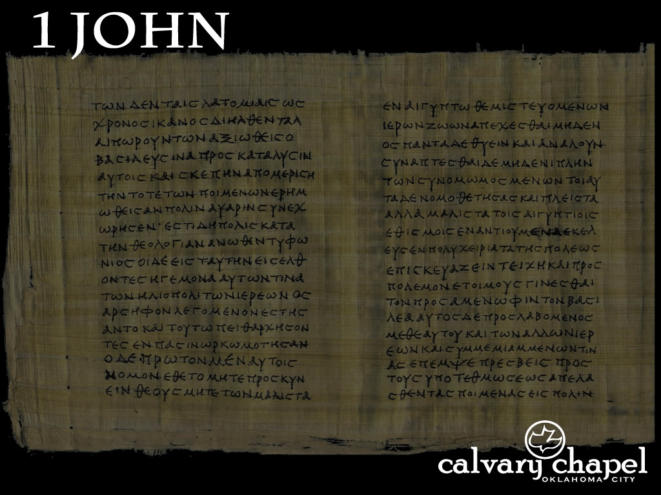


1:5-10
Gnosticism’s fundamental error: all matter is inherently evil
Theological error: Who Jesus is and what He accomplished
Practical error: Either abject asceticism or extreme libertinism
FLESH-O-METER
Ascetics
Libertines

Slide 3
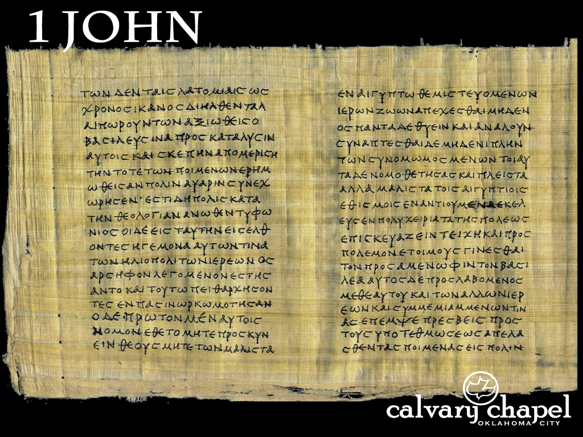
1:5-10

Slide 4
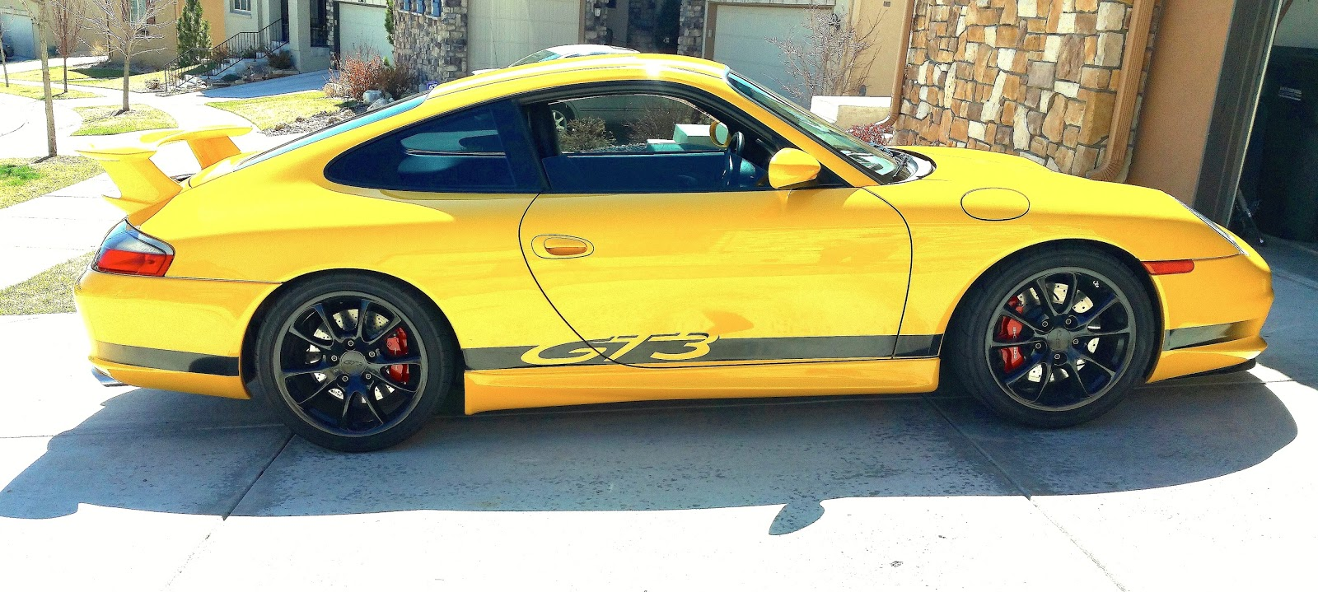
1:5-10

Slide 5
1:5-10

Slide 6
1:5-10
3 false claims of sin:
1. Sin’s duplicity (v. 6)
2. Sin’s depravity (v. 8)
3. Sin’s deeds (v.108)

Slide 7
1:5-10

Slide 8
1:5-10

Slide 9
1:5-10

Slide 10
1:5-10
1st false claim (sin’s duplicity):
Walk ~ peripateō – peri, around; pateō, to tread
Book of Acts:
Savior (2x)
Lord (over 100x)

Slide 11
1:5-10

Slide 12
1:5-10
Cleanses ~ katharizō – cathartic

Slide 13
1:5-10

Slide 14
1:5-10
Prov. 18:24 ~ A man who has friends must himself be friendly,
But there is a friend who sticks closer than a brother.

Slide 15
1:5-10

Slide 16
1:5-10
John R. W. Stott ~ “Sin and the child of God are incompatible. They may occasionally meet; they cannot live together in harmony.”

Slide 17
1:5-10

Slide 18
1:5-10
2nd false claim (sin’s depravity):
Phillips ~ If we refuse to admit that we are sinners, then we live in a world of illusion and truth becomes a stranger to us.
C. S. Lewis ~ “No man knows how bad he is till he has tried very hard to be good.”

Slide 19
1:5-10
Ps. 32:1-6a ~ ¹ Blessed is he whose transgression is forgiven,
Whose sin is covered.
² Blessed is the man to whom the LORD does not impute iniquity,
And in whose spirit there is no deceit.
³ When I kept silent, my bones grew old
Through my groaning all the day long.
⁴ For day and night Your hand was heavy upon me;
My vitality was turned into the drought of summer. Selah

Slide 20
1:5-10
Ps. 32:1-6a ~ ⁵ I acknowledged my sin to You,
And my iniquity I have not hidden.
I said, “I will confess my transgressions to the LORD,”
And You forgave the iniquity of my sin. Selah
^{6a} For this cause everyone who is godly shall pray to You
In a time when You may be found;

Slide 21
1:5-10

Slide 22
1:5-10
Confess ~ homologeō – to say the same thing
Amos 3:3 ~ Can two walk together unless they are agreed?

Slide 23
1:5-10

Slide 24
1:5-10
C. H. Spurgeon: “The text means just this - Treat God truthfully, and he will treat you truthfully. Make no pretensions before God, but lay bare your soul, let him see it as it is, and then he will be faithful and just to forgive you your sins and to cleanse you from all unrighteousness.”
Prov. 28:13 ~ He who covers his sins will not prosper, but whoever confesses and forsakes them will have mercy.

Slide 25
1:5-10

Slide 26
1:5-10
3rd false claim (sin’s deeds):

Slide 27
1:5-10

